Slide 1
APRS Reference & Ground Terminal – Weekly meeting
FERRER, Javier
Date: 2023/04/26
Meeting: In-person meeting
Time: 02:40 PM – hh:mm JST

Slide 2
Tasks performed during this week
Checking S&F MCU board coding
Ground Terminal
BIRDS-X room

Slide 3
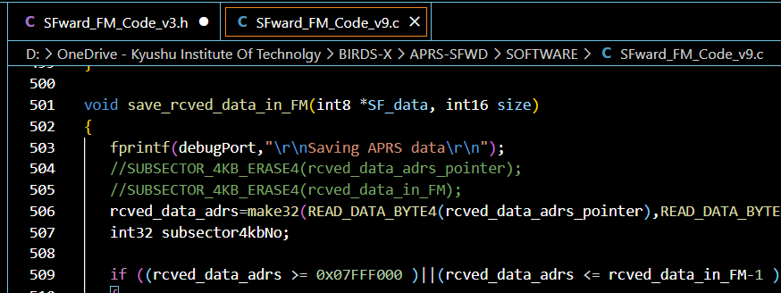
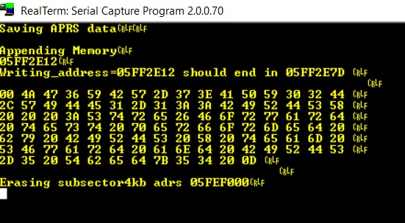
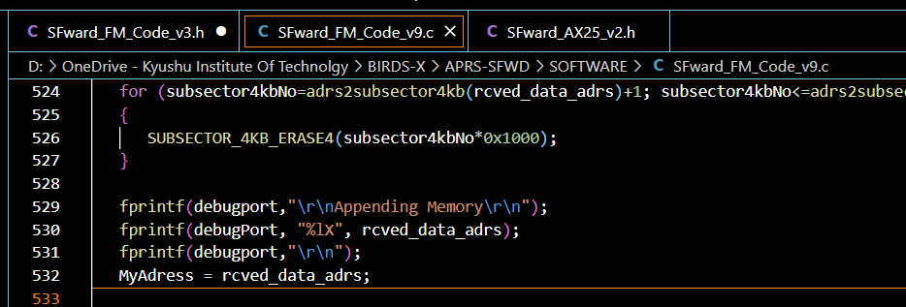
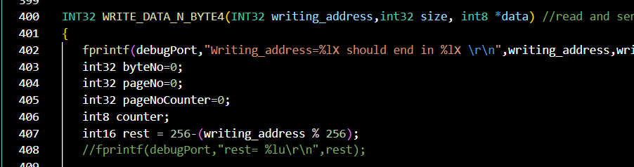
Checking S&F MCU board coding
BIRDS-3
FAB
APRS- S&F board

Slide 4
Ground Terminal
VHF Omnidirectional Antenna
SPI
Transceiver
Sensors
BIRDS-3
FAB
UART
MCU & TNC
EPS
SPI
Flash Memory
BIRDS-5
OBC
Block diagram MDR

Slide 5
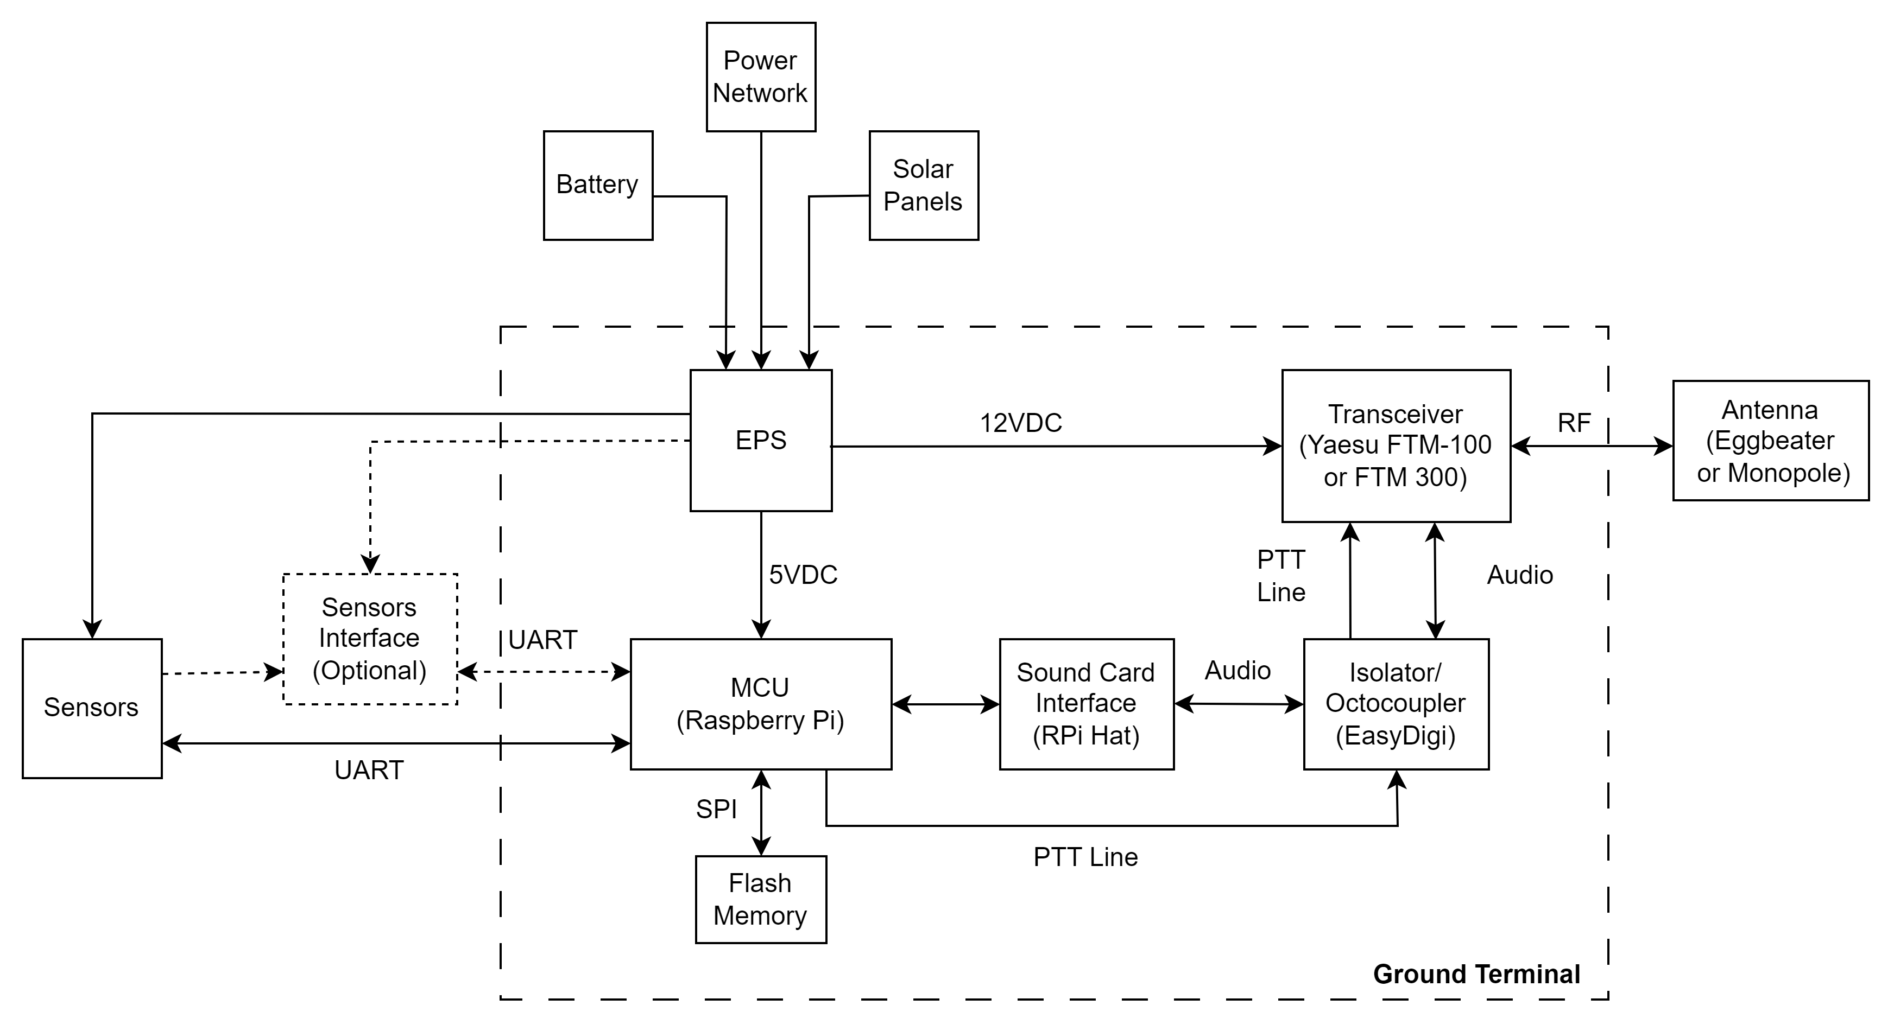
Ground Terminal
BIRDS-3
FAB
BIRDS-5
OBC
Block diagram - updated

Slide 6
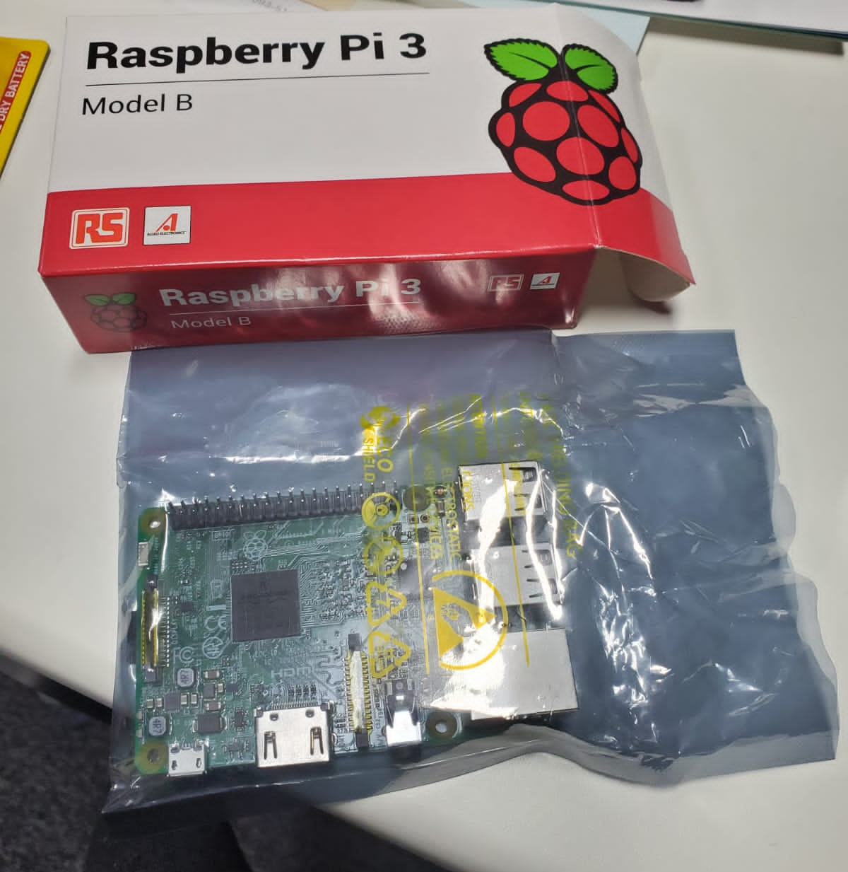
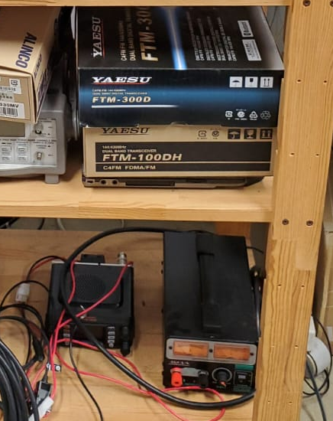
Hardware available for testing
BIRDS-3
FAB
Raspberry Pi 3B
BIRDS-5
OBC
Transceivers
Yaesu FTM-100DH
Yaesu FTM-300D

Slide 7
Next tasks
Start coding the BIRDS-X S&F version adapted to commands coming from BIRDS-X Mission Boss
Ground Terminal hardware components procurement.
BIRDS-X room
BIRDS-3
FAB
BIRDS-5
OBC

Slide 8
APRS Reference & Ground Terminal – Weekly meeting
FERRER, Javier
Date: 2023/04/19
Meeting: In-person meeting
Time: 02:40 PM – hh:mm JST

